Slide 1
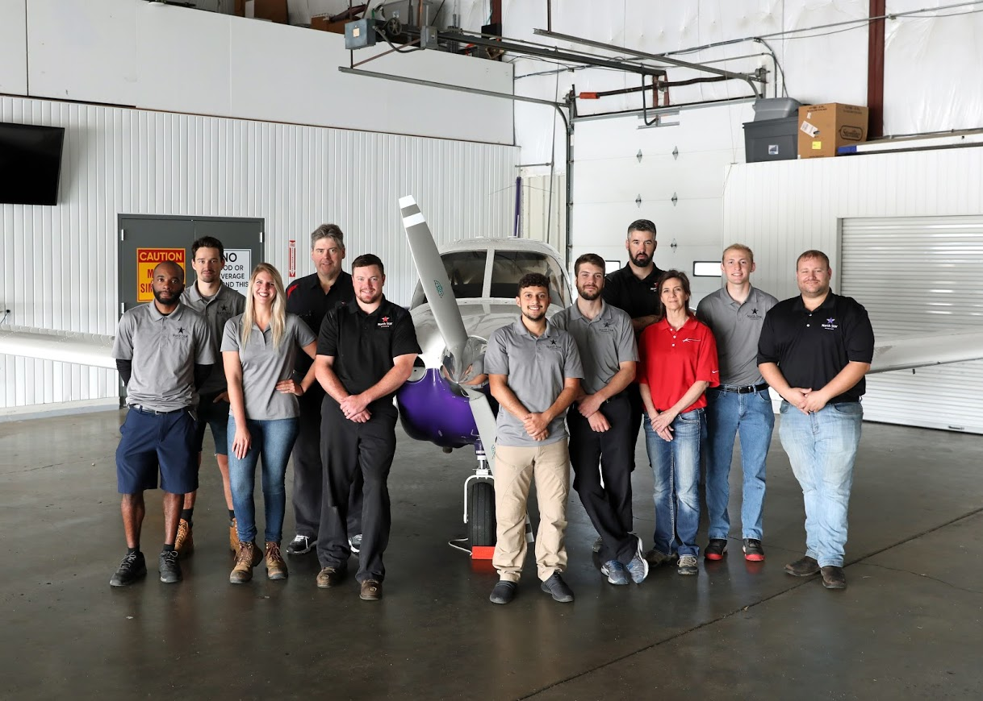
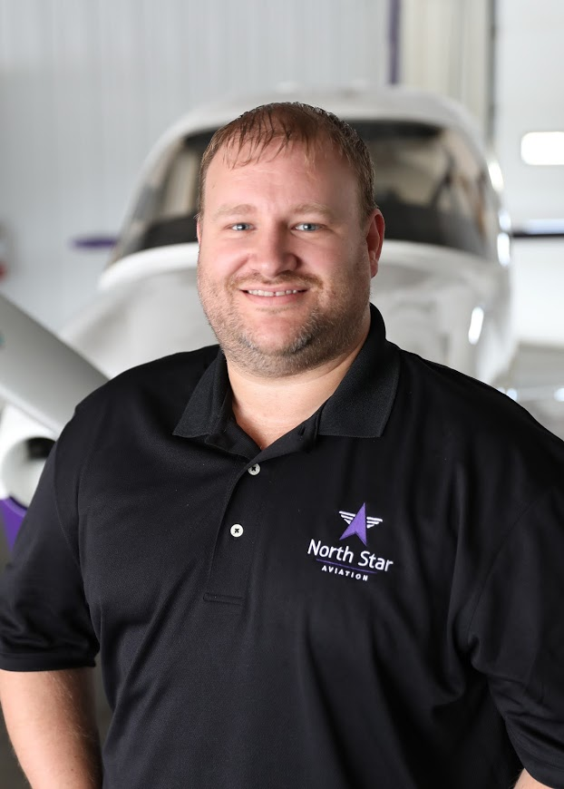
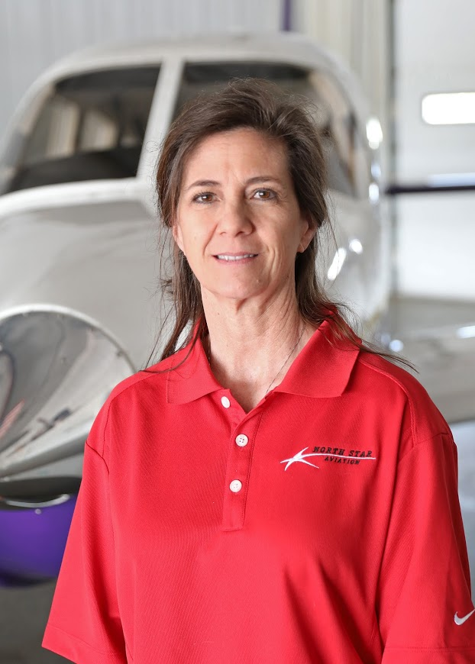
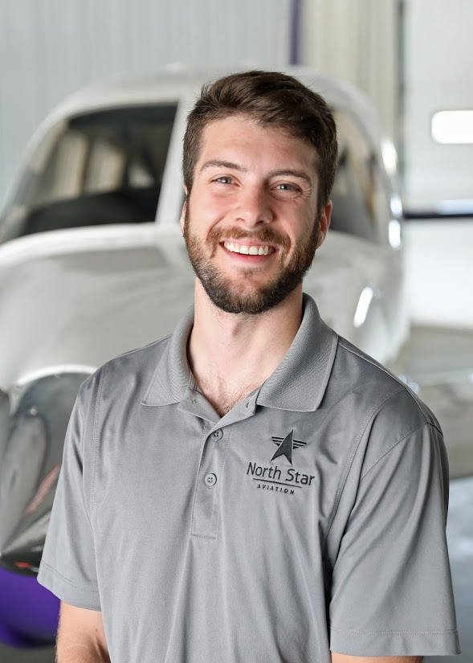
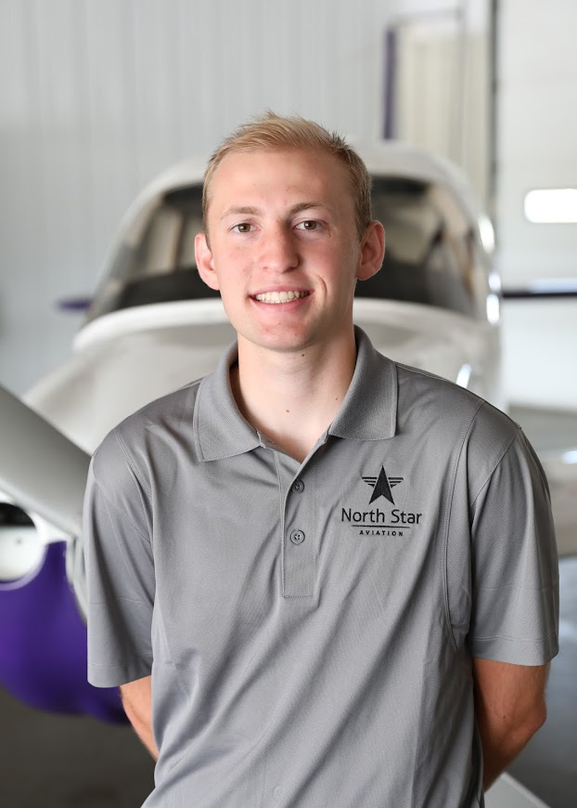
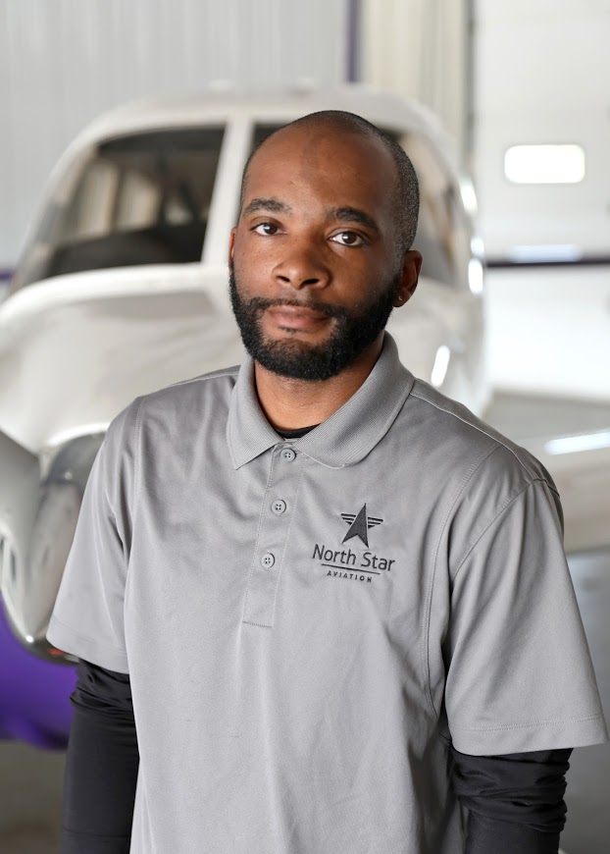
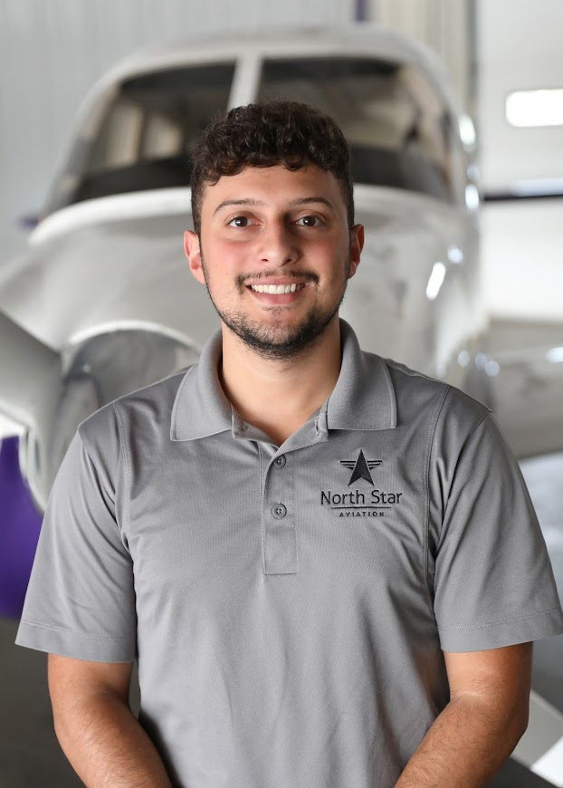
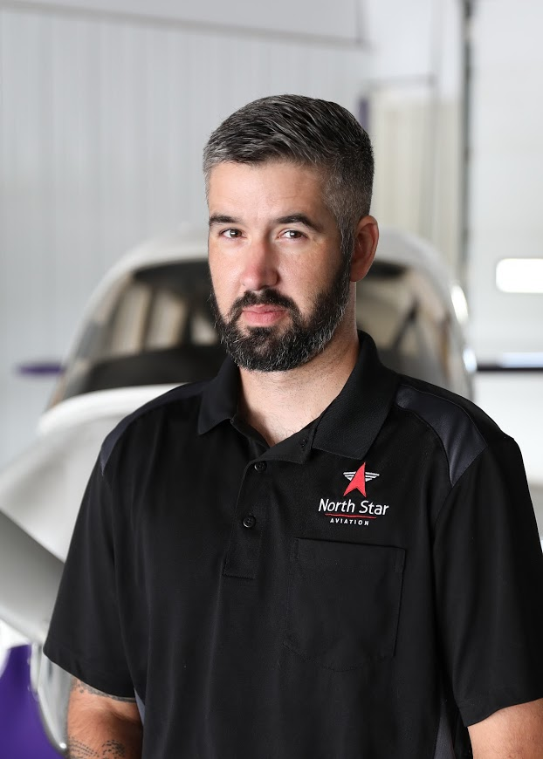
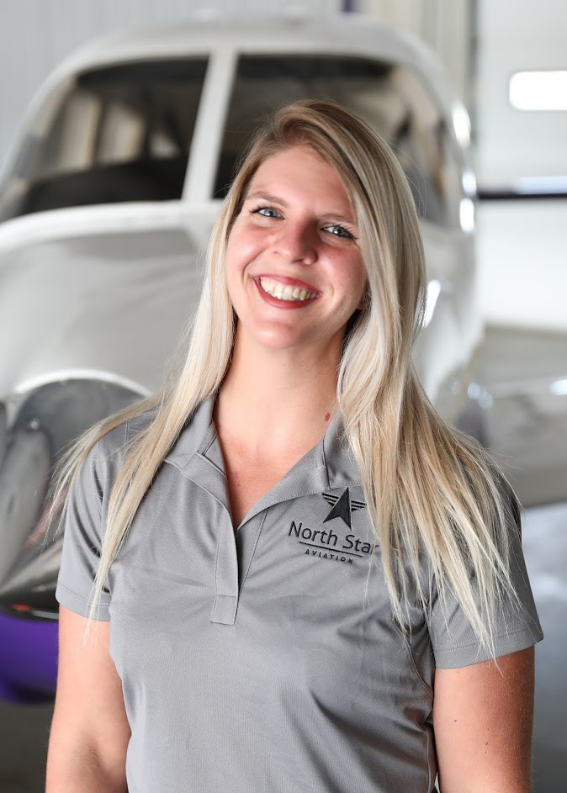
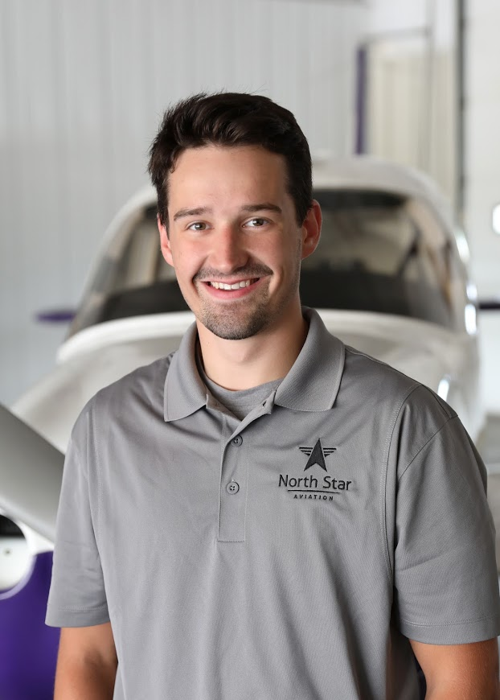
North Star Aviation Maintenance Department
Ryan Williams
Director of Maintenance
Jon Wieland
Chief Inspector
Kathy Fox
Material Control
Stefan Boemer
Avionics Manager
Jack Simmons
Intern
Trevon Elliot
Maintenance Tech
Alex Thompson
Maintenance Tech
Avedis Shukrian
Maintenance Tech
Gabe Soehren
Maintenance Tech
Amber Mielke
Maintenance Tech
Evan Thompson
Intern

Slide 2
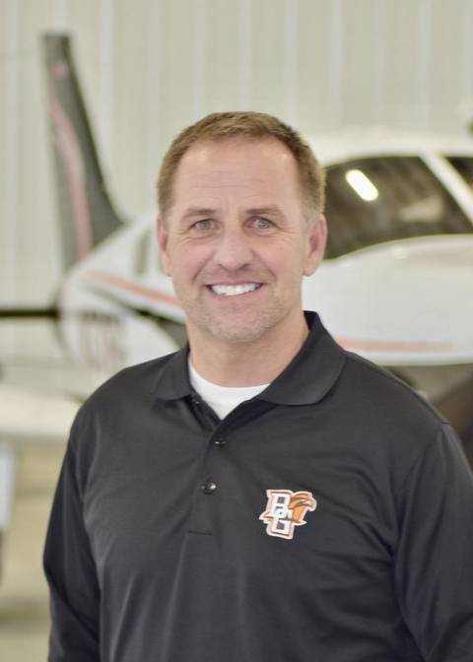
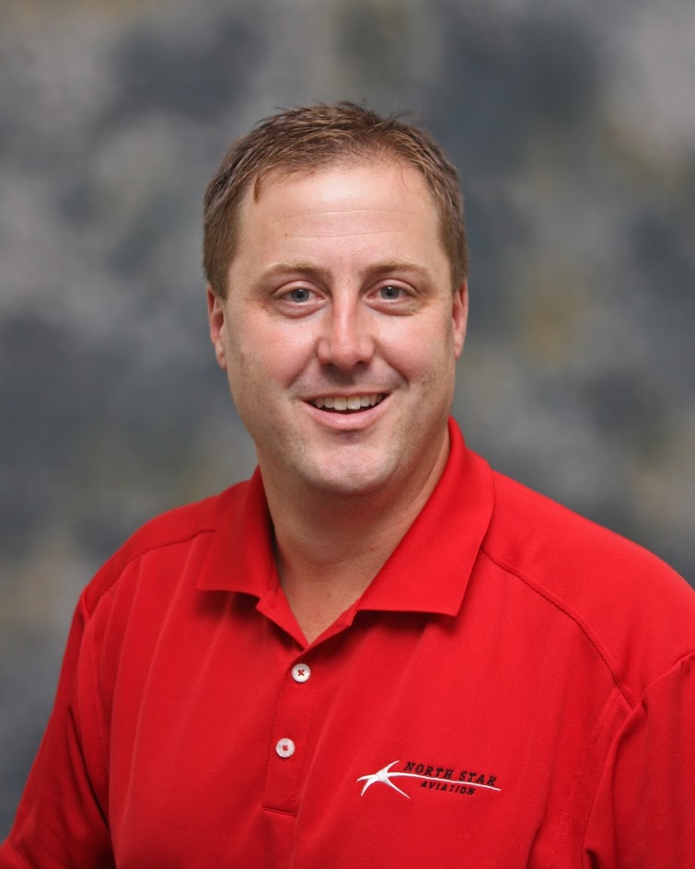
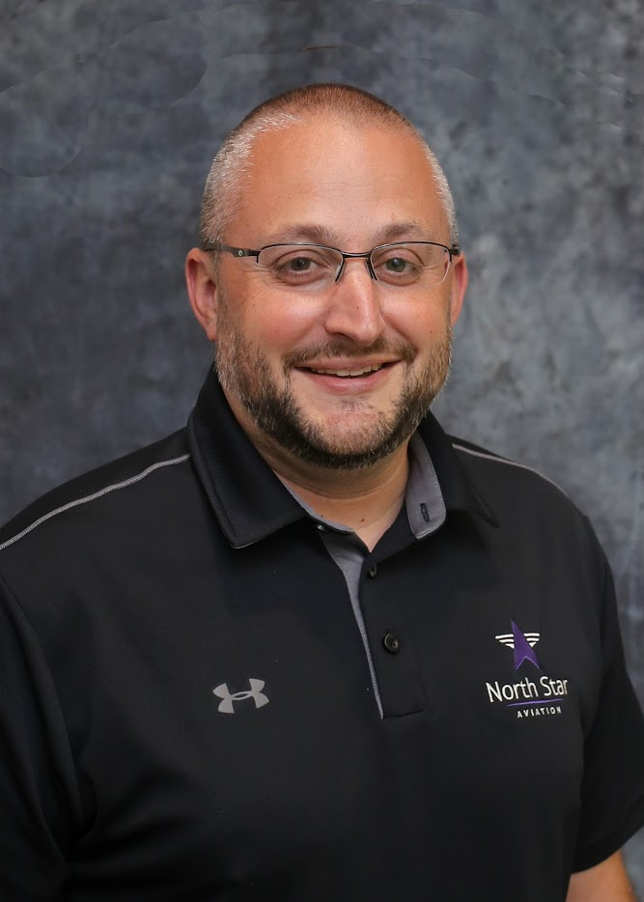
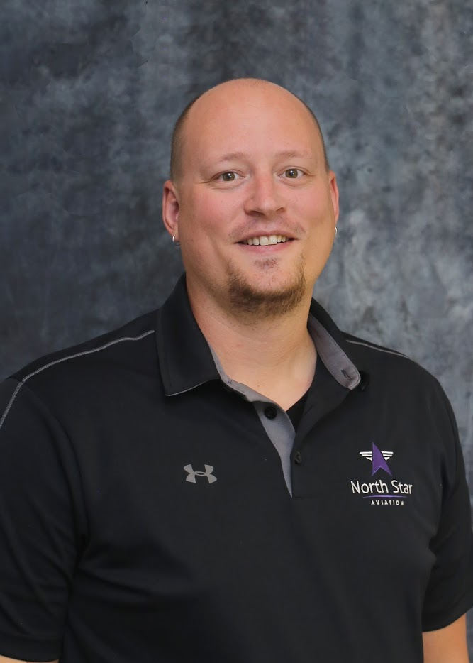
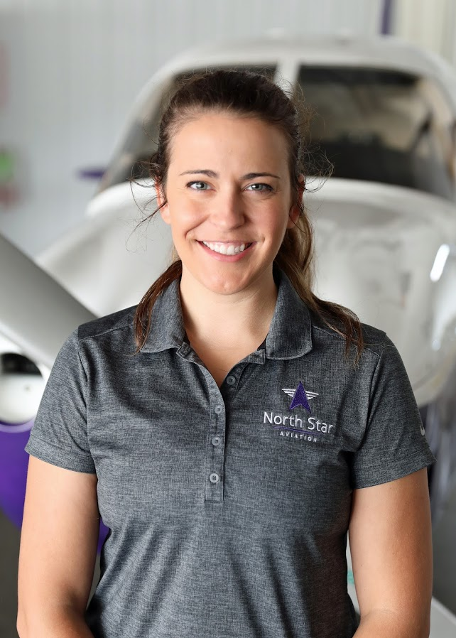
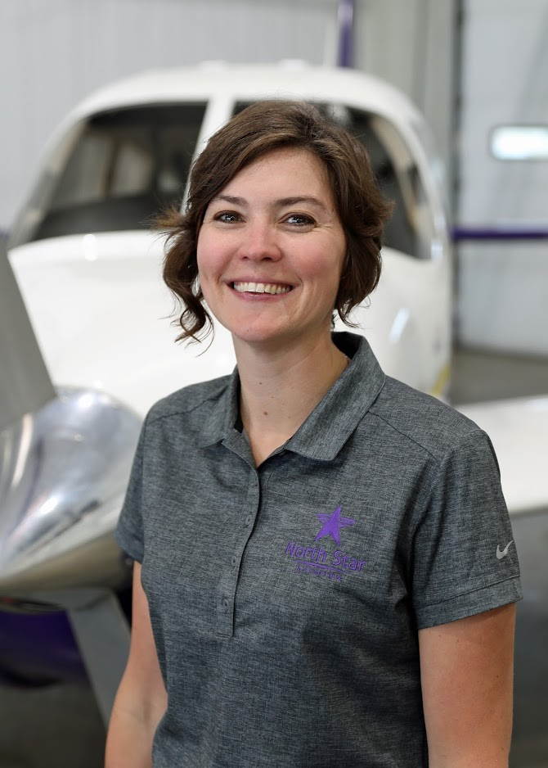
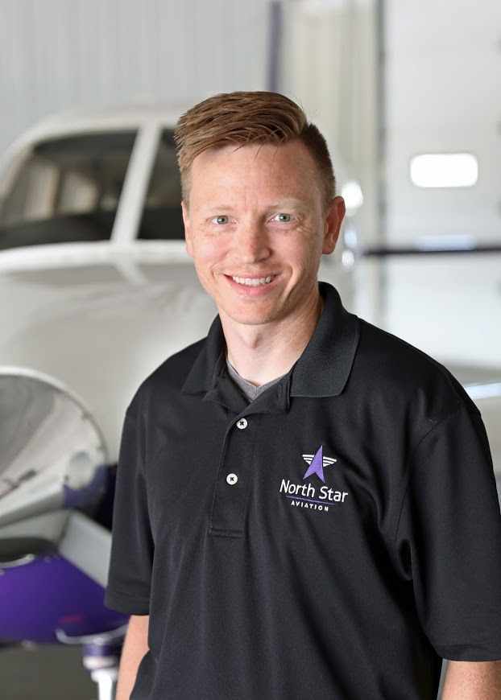
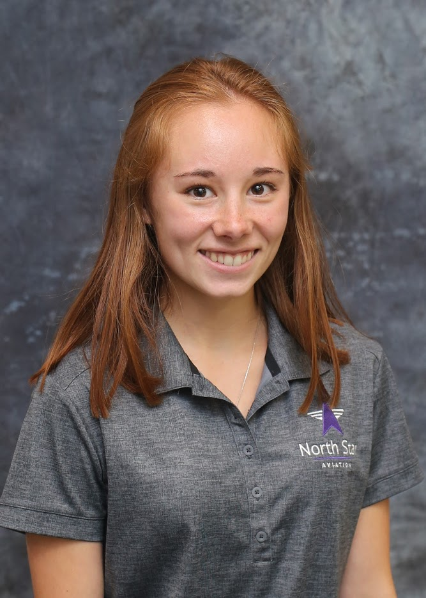
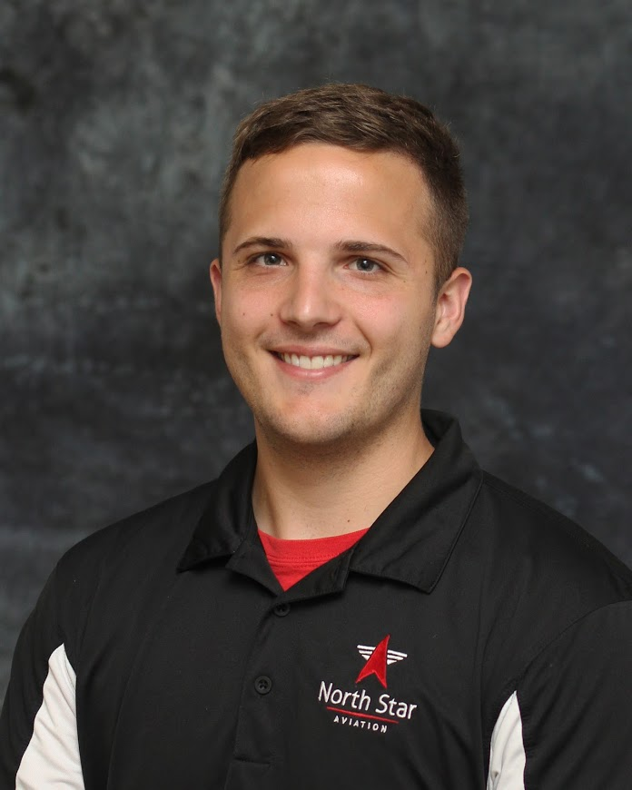
North Star Office Admin
Jerry Redman
Vice President
Rob McGregor
General Manager
Bryant Stiernagle
Financial Controller
Matt Holt
Human Resources
Brooke Foley
Office Manager/Coordinator
Leah Schmidt
Head Dispatcher
Brian Rutt
Safety Manager
Allie Draper
Head Liaison
Cody Howe
Director of Flight School Operations

Slide 3
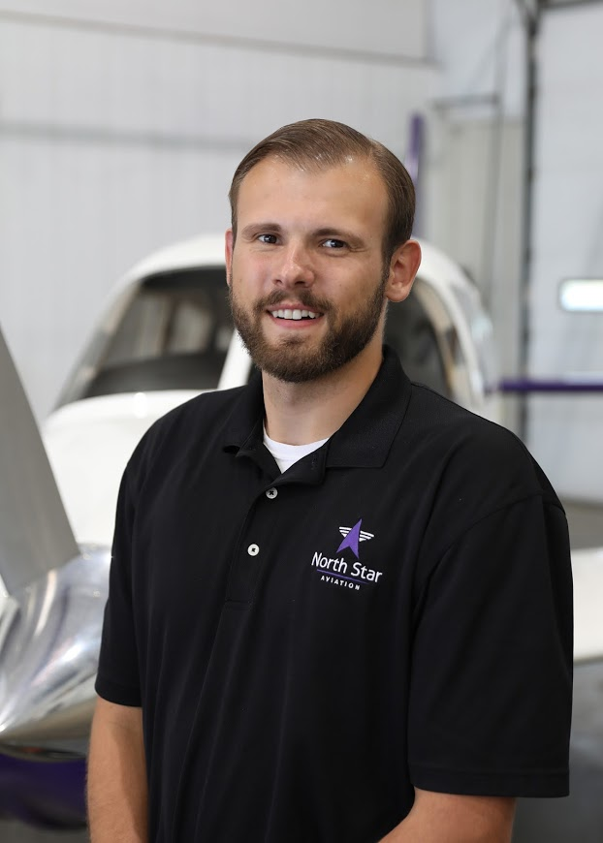
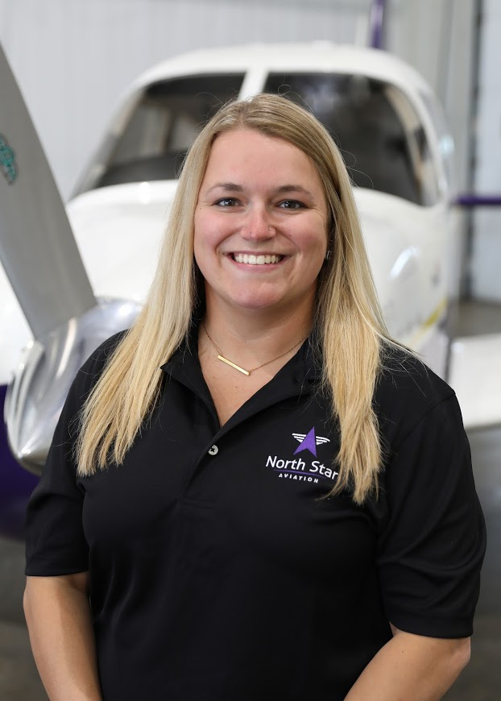
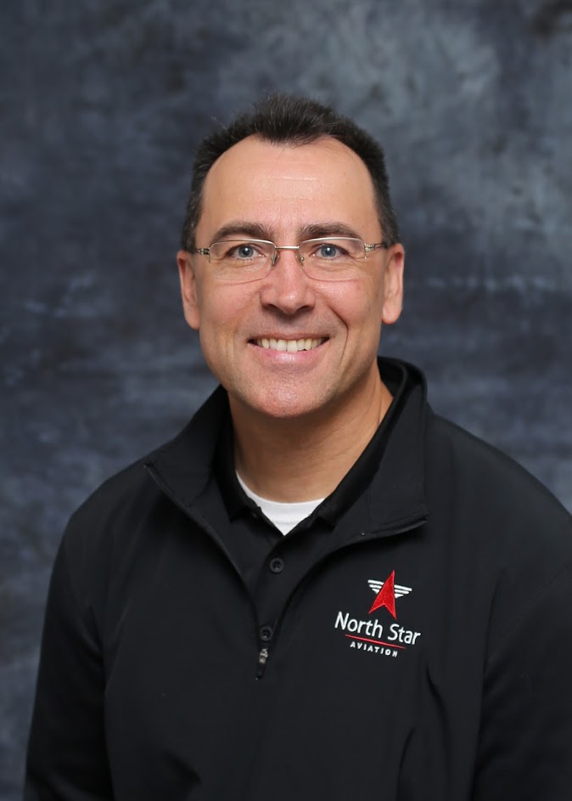
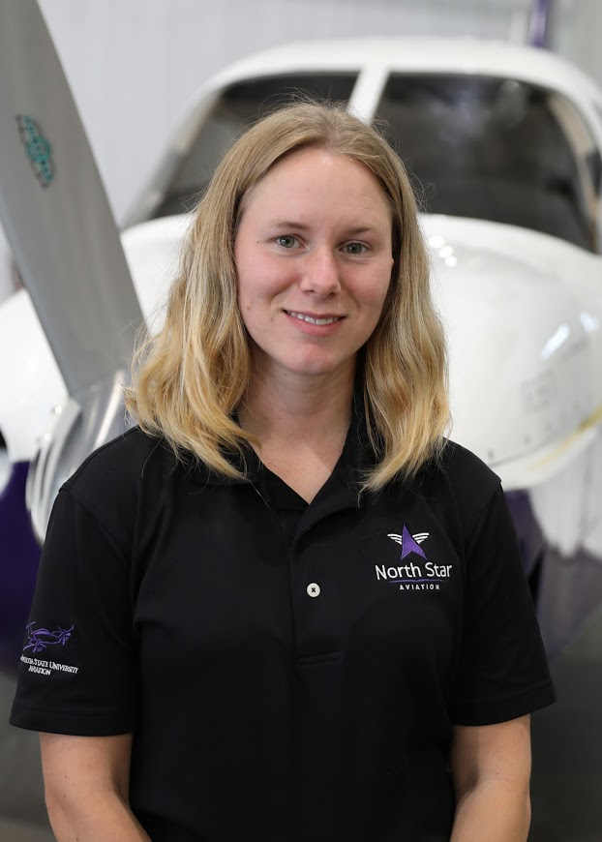
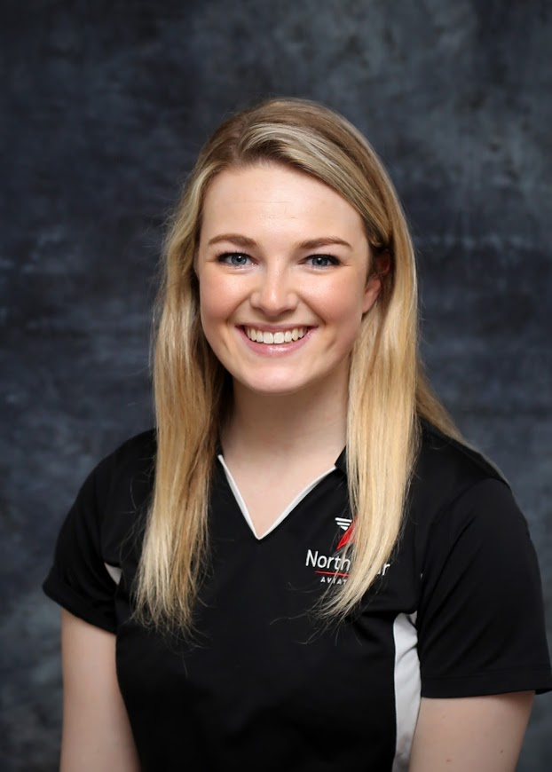
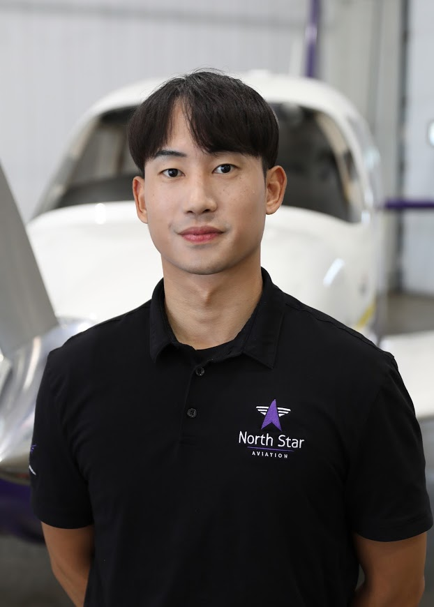
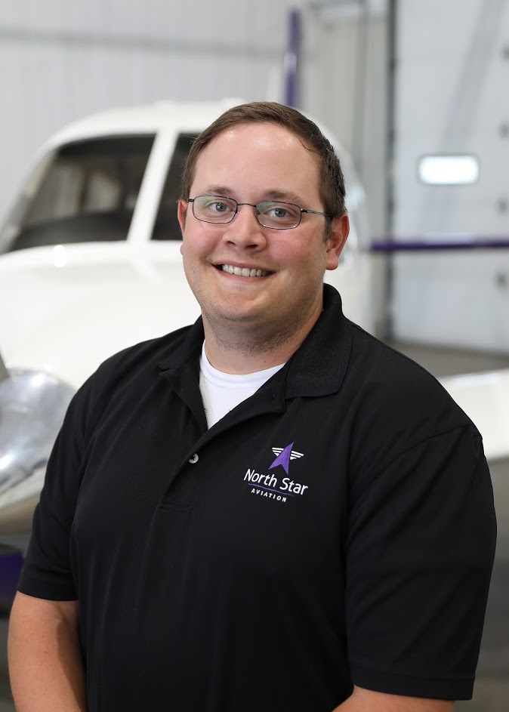
North Star Aviation Chief and Assistant Chief Flight Instructors
Chris Plasek
Chief Flight Instructor
Jessica Adams
Assistant Chief Flight Instructor
Kevin Case
Assistance Chief Flight Instructor
Amanda Sheridan
Assistant Chief Flight Instructor
Sidney Peterson
Assistant Chief Flight Instructor
Woncheul Lee
Assistant Chief Flight Instructor
Brad Hartman
Assistant Chief Flight Instructor

